Slide 1
Role of AI in IOT

Slide 2
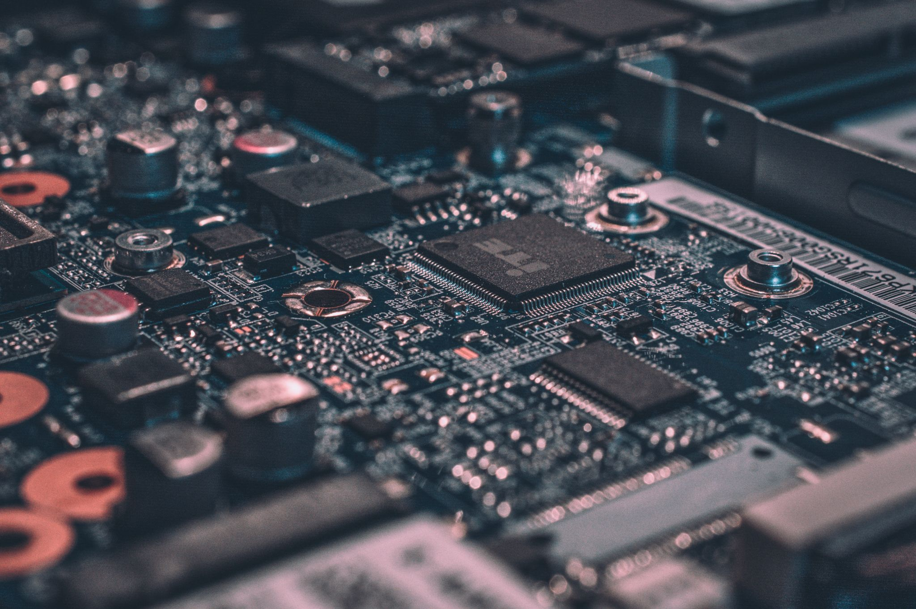

WHAT IS IOT?

Slide 3
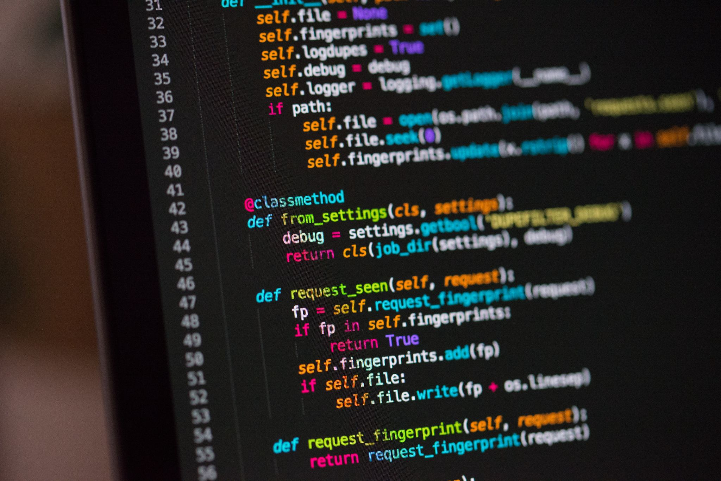
AI in IOT?

Slide 4
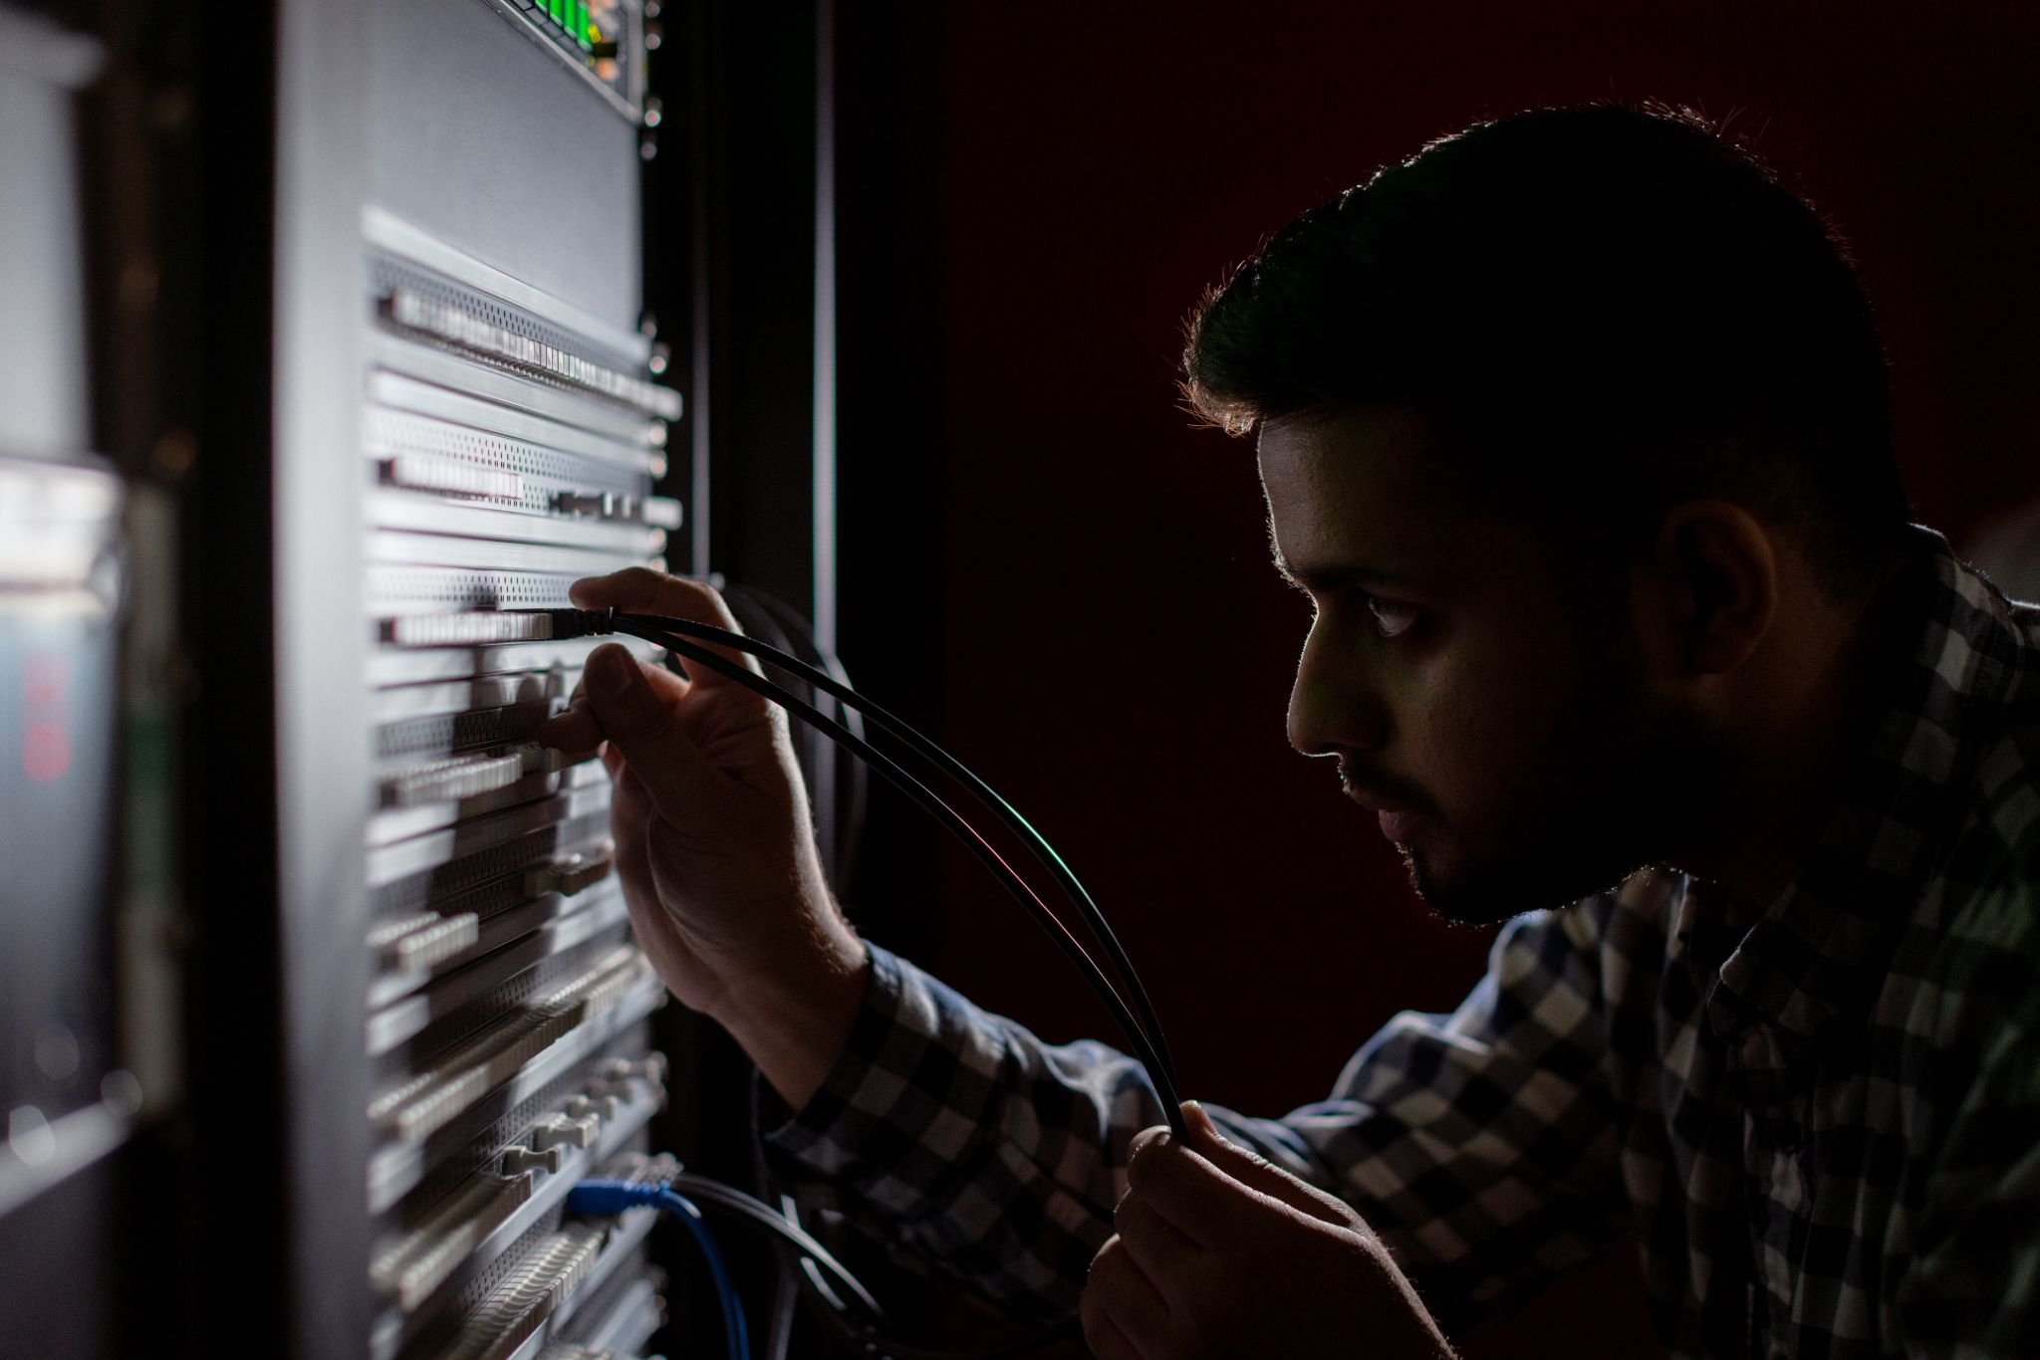
Avoiding Costly Unplanned Downtime

Slide 5
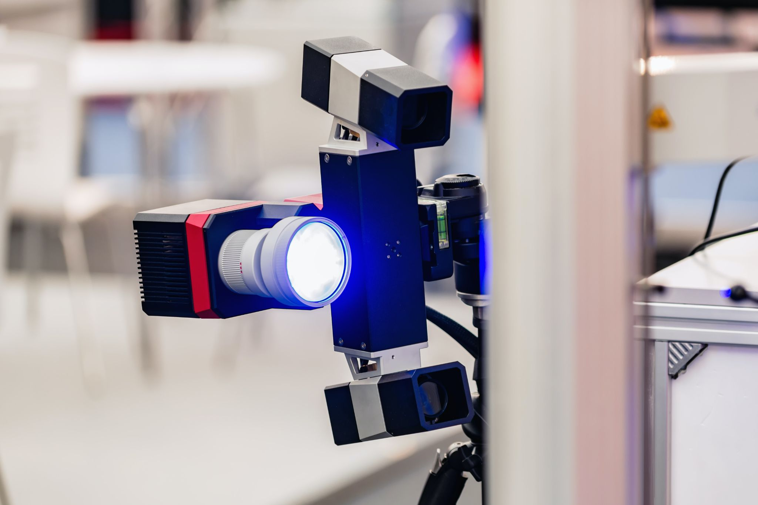
Operational Efficiency

Slide 6
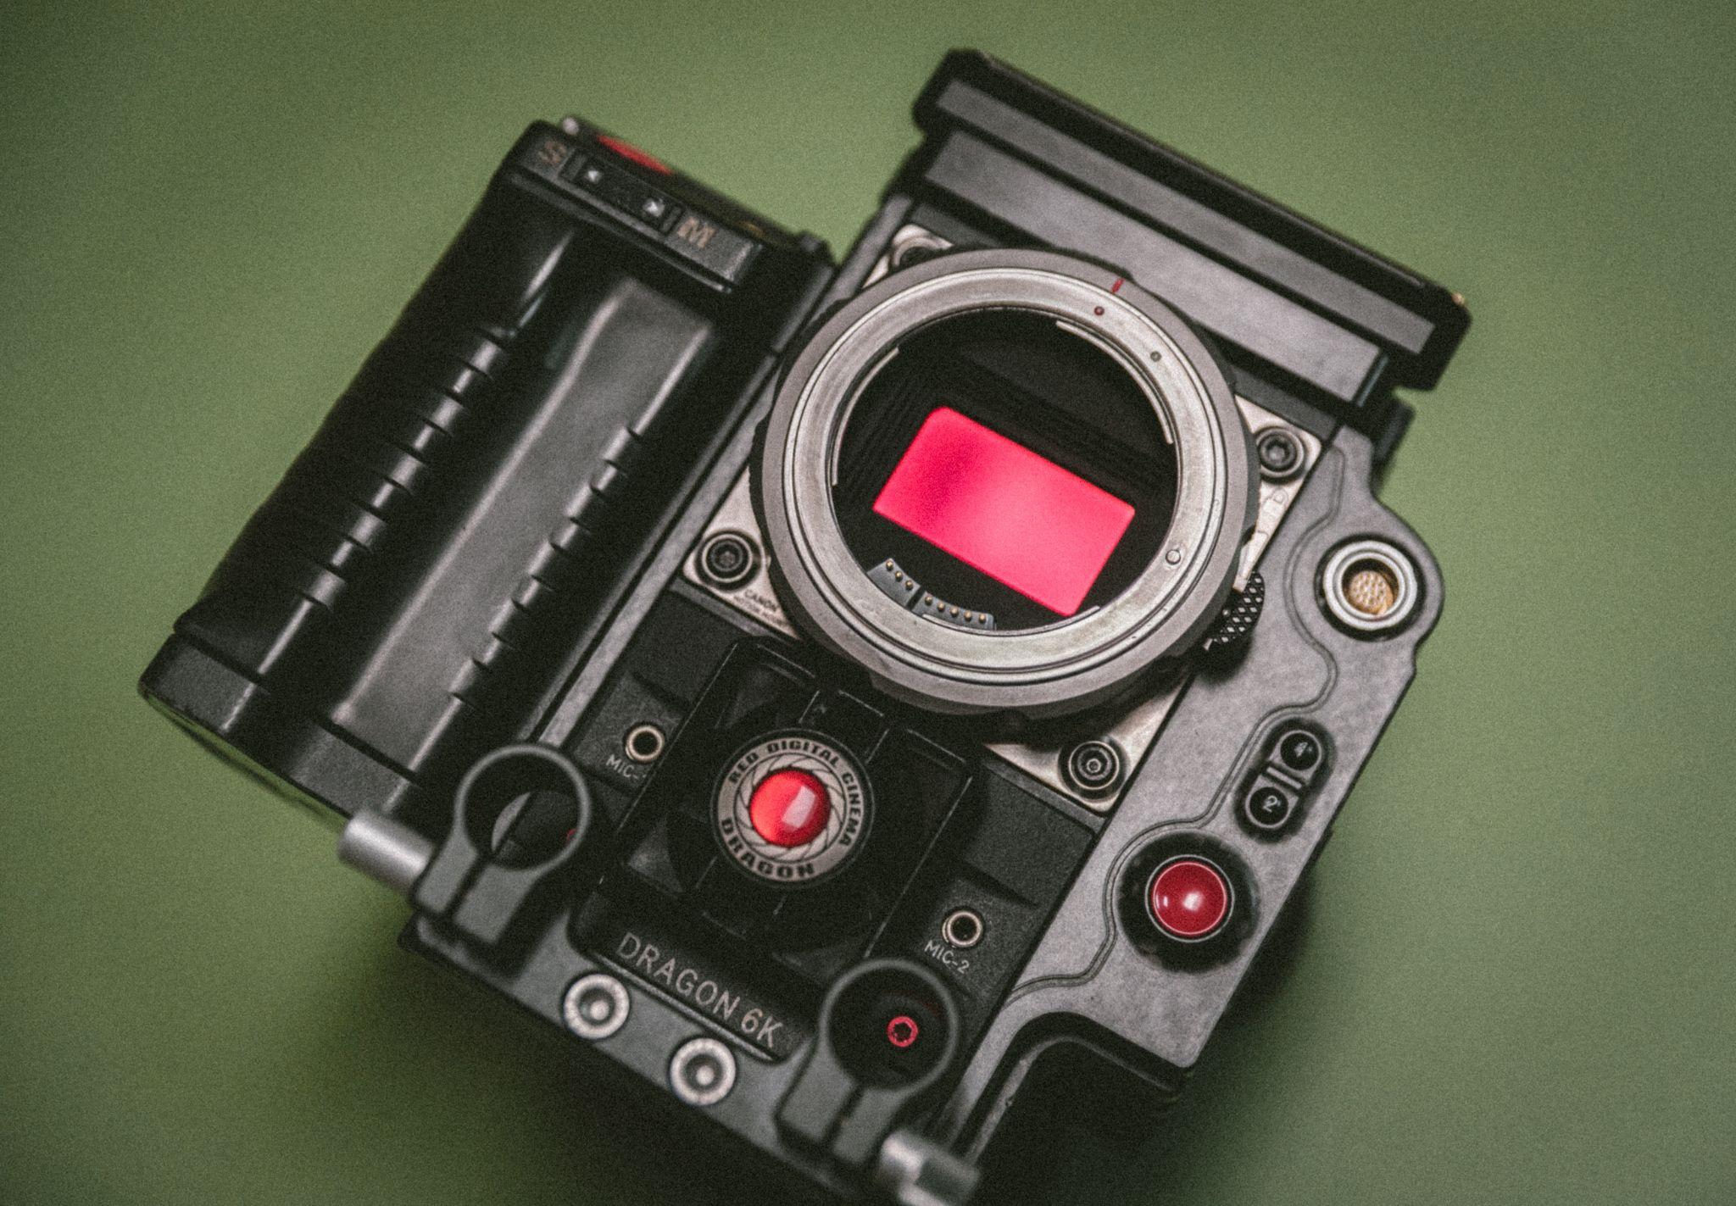
Enabling New And Improved Products And Services

Slide 7

The Future Of Iot Is AI

